Slide 1







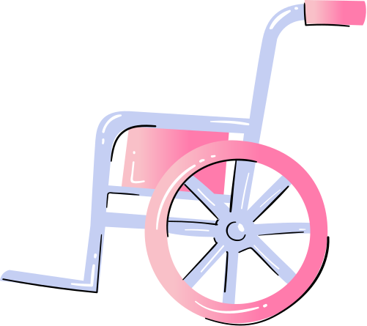



An Informal Diagnosis:
Implicit Bias in AI Summarization of Discharge Notes in Electronic Health Records
Javokhir Arifov, Philip Baillargeon
CS 329R

Slide 2
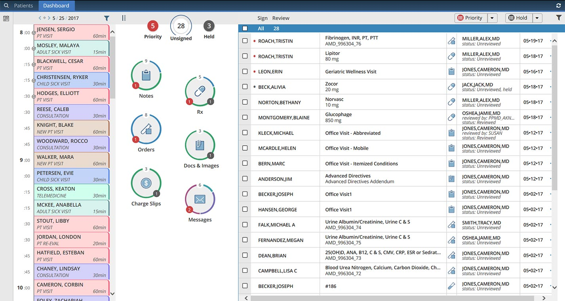

Notes:
Phil
We’ve all had the experience of going to the doctor and having them click through some software, asking you questions you’ve been asked thousands of times before, asking you about info that’s been wrong since you were 10 but can’t seem to get corrected. Electronic health records are the standardized way our health information is shared between doctors. It’s no secret, though, that even though they can be shared, they’re kind of a mess.

Slide 3
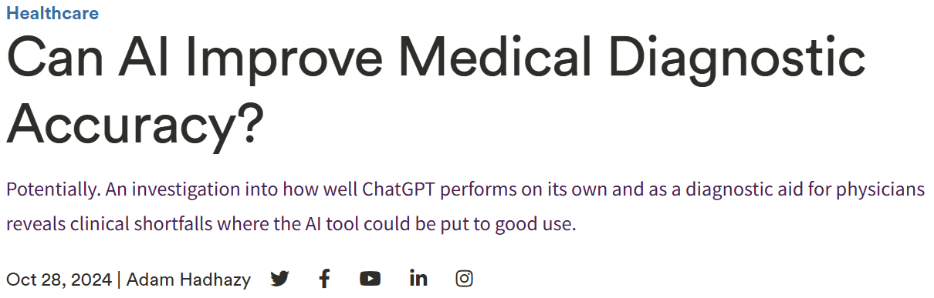
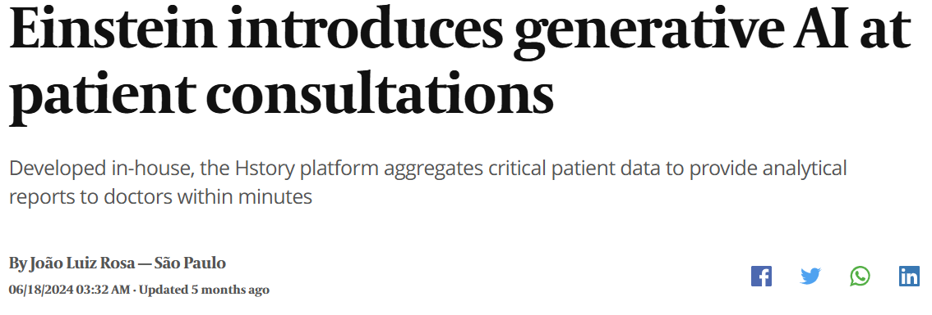


Notes:
Phil
Since these systems are impossible to use, AI is being introduced to summarize and condense these instructions

Slide 4

Justifications for AI Summaries
Doctors have to review records that can be hundreds of pages long in seconds in an emergency scenario
Natural language descriptions can be difficult to find among test results, numerous prescriptions, and other templated information
Saves time, reduces cognitive load
Notes:
Javo

Slide 5

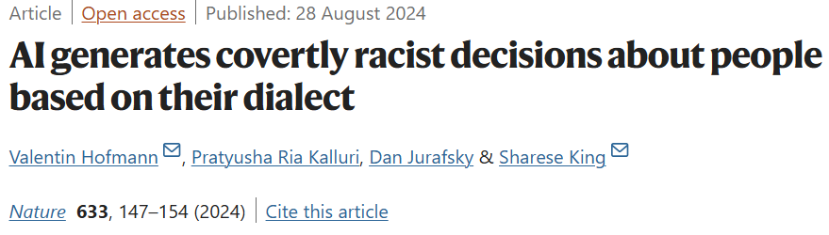
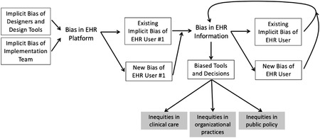
Concerns with
AI Summaries
EHR is structured in a way that promotes implicitly biased decision making (Rozier 2022)
Free text fields present choices:
eg. is a mother “concerned” or “aggressive”?
Fears of hallucination, omitting important details, fixating on irrelevant information
Notes:
Javo

Slide 6

Our Data
100,000+ free text emergency room records from the MIMIC-IV dataset (anonymized records from Beth Israel Deaconess Medical Center in Boston, Massachusetts)
Each record comes with sections for Chief Complaint, Patient History, Hospital Course, Discharge Instructions etc.
Each patient record is identified by race (White, Black, Hispanic, Asian, along with infrequent more specific identifiers like “Russian/Portuguese”) and gender (M, F, Other)
Notes:
Javo

Slide 7
Research Questions
How do descriptions of hospital courses in electronic health records vary across race?
“concerned” vs. “aggressive” problem
How do descriptions of hospital courses differ within a racial group and across gender?
How do AI generated summaries of these records differ from the original records with respect to biased language?
Notes:
Phil
We had three main research questions: first, we wanted to know if there were high level semantic differences in how people are described
We also wanted to do intersectional analysis, seeing whether or not treatment within groups had any concerning trends
Finally, we summarized several thousand records using GPT-3.5 to assess differences

Slide 8
Method
Calculate word vectors for every race subset
Use Principal Component Analysis (PCA) to map word vectors onto two dimensional space, find clusters
Plot relative frequencies of words across race subsets (“log-odds”)
Repeat this process for AI generated summaries
Summaries generated using GPT-3.5 with a prompt based on prior work and a given example of a discharge summary
Notes:
Phil

Slide 9
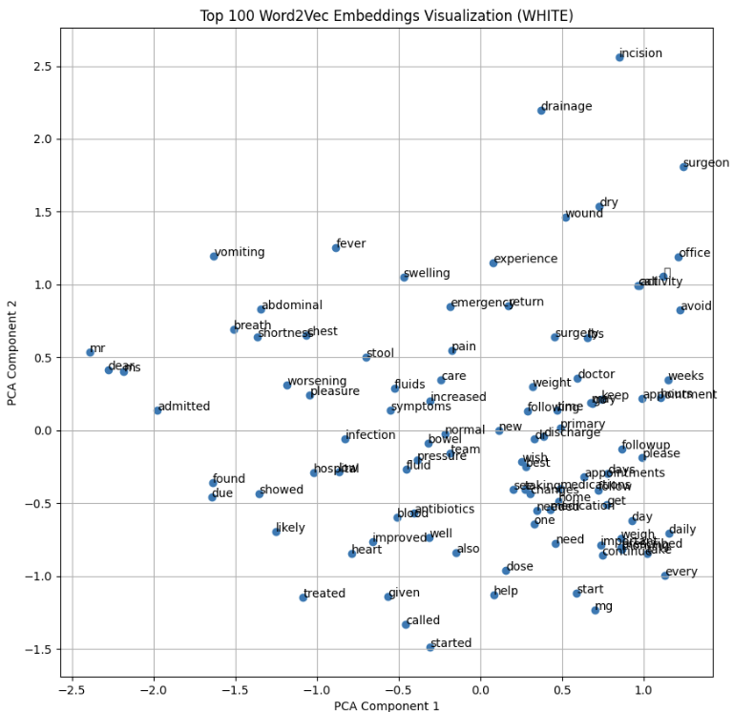
Symptoms
Formality
Treatment Plan
Notes:
Phil

Slide 10
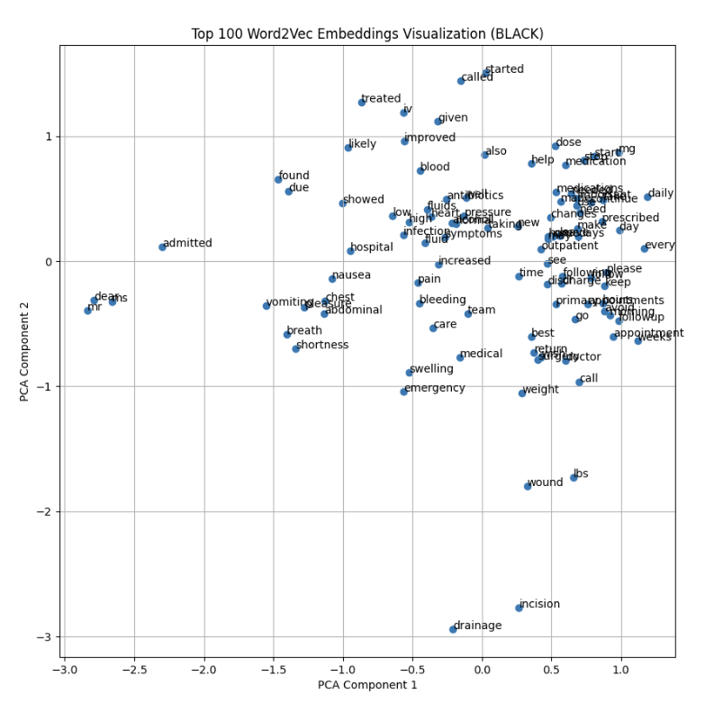
Spread out Explanation, Clustered Instruction
PCA Analysis - White
PCA Analysis - Black
Notes:
Javo
Taking a look at the PCA analysis of 100k sections of discharge instructions across White and Black patients. We seem to have a denser clustering of the terms involved with treatment instructions as opposed to explanations and summaries. While this is not a definitive test, it could suggest to us that there is less variation in the language that directions are given to Black patients.

Slide 11
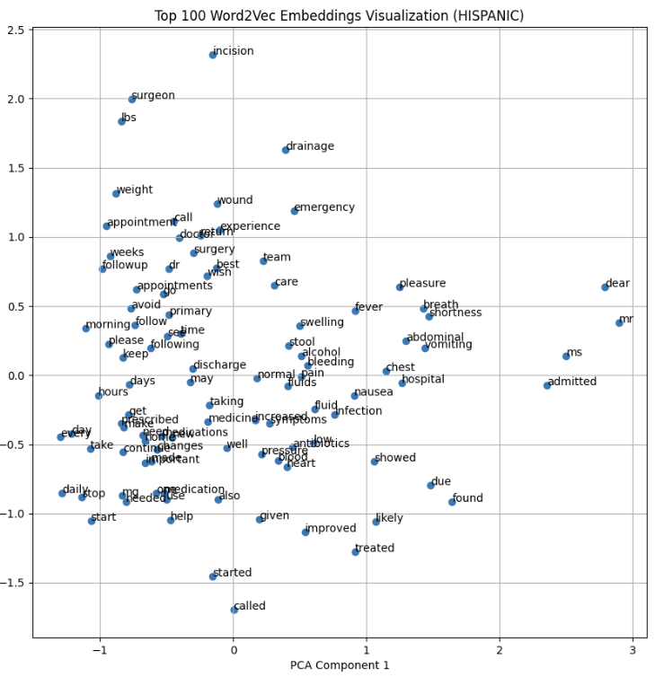
PCA Analysis - White
PCA Analysis - Hispanic

Slide 12
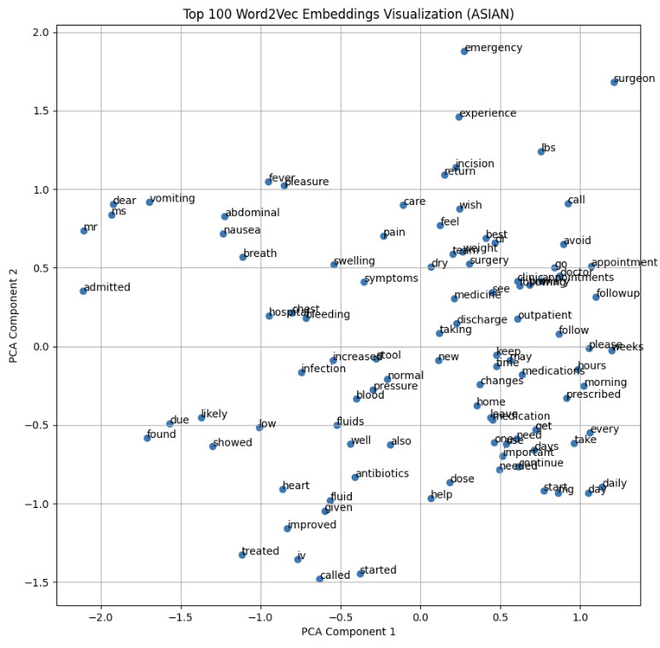
PCA Analysis - White
PCA Analysis - Asian

Slide 13
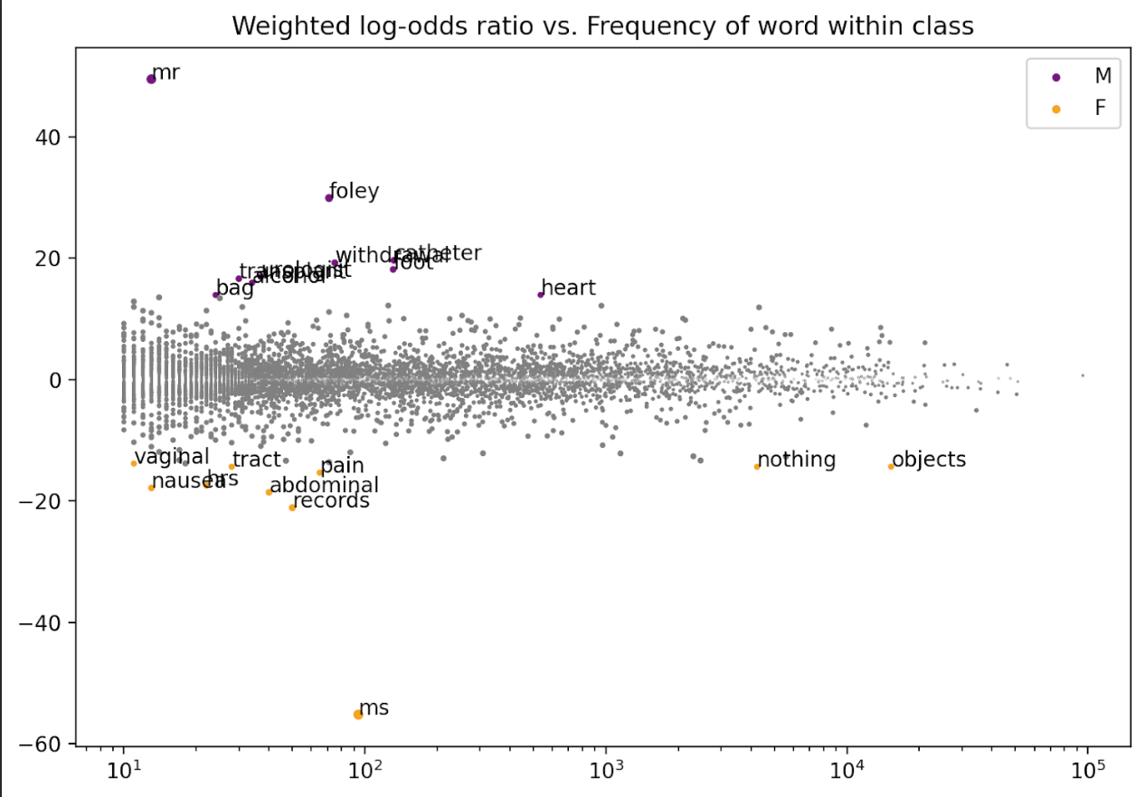
Fightin Words
Z-Score
(larger magnitude, stronger association)
Frequency
Notes:
Javo
We use the Fightin words method, which we have seen before in the discrimination self-disclosure papers, to analyze associations for words across groups in a corpus using the ConvoKit library.

Slide 14
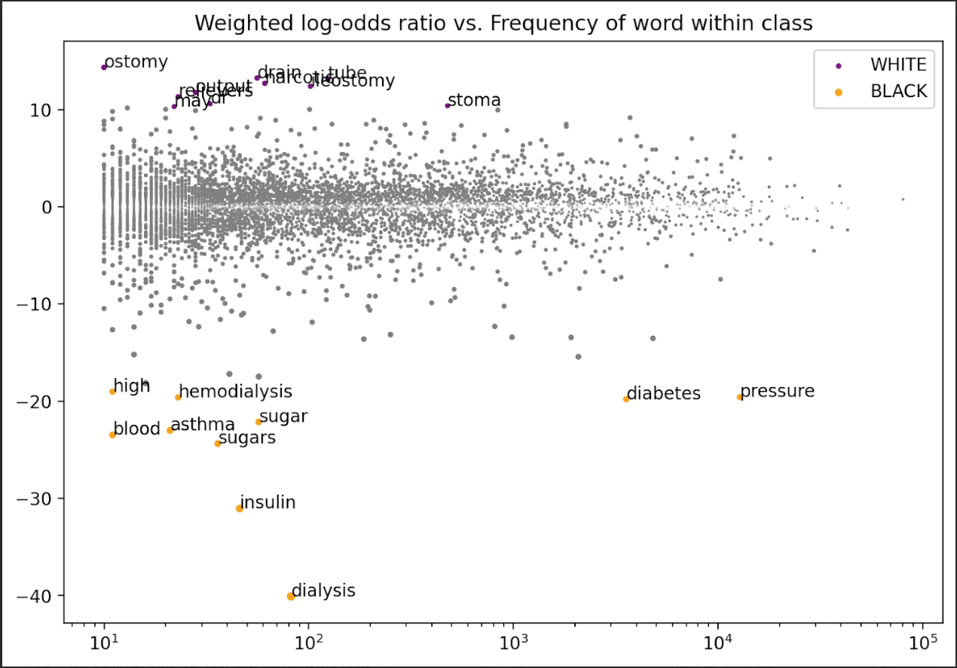
Log Odds - White/Black
Notes:
Javo

Slide 15
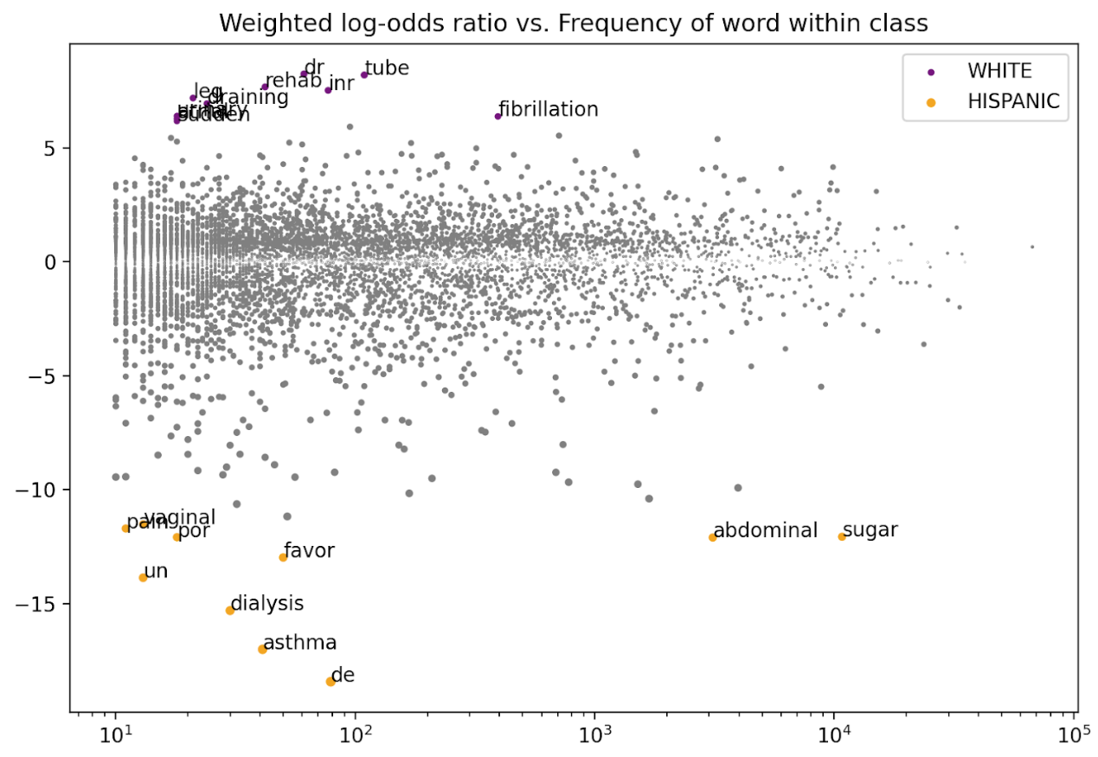
Log Odds - White/Hispanic
Notes:
Javo

Slide 16
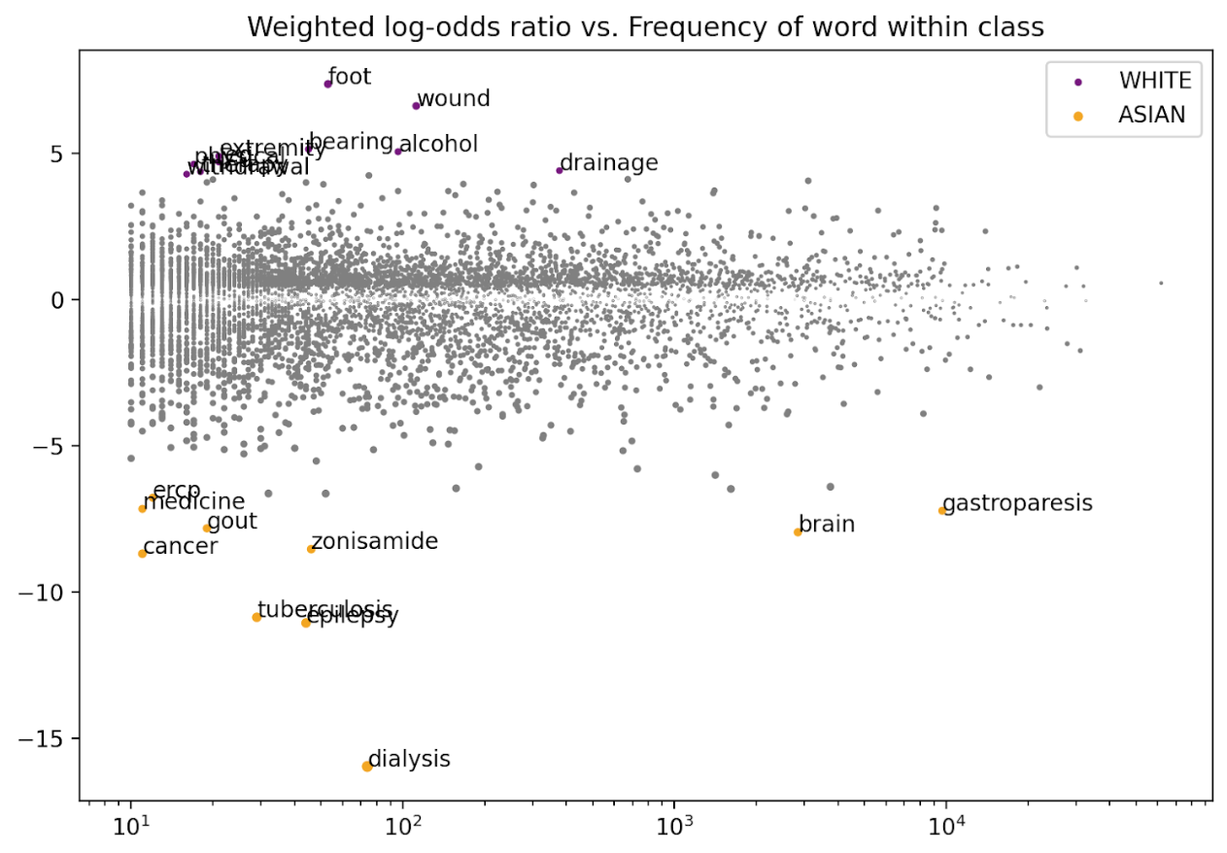
Log Odds - White/Asian
Notes:
Javo

Slide 17
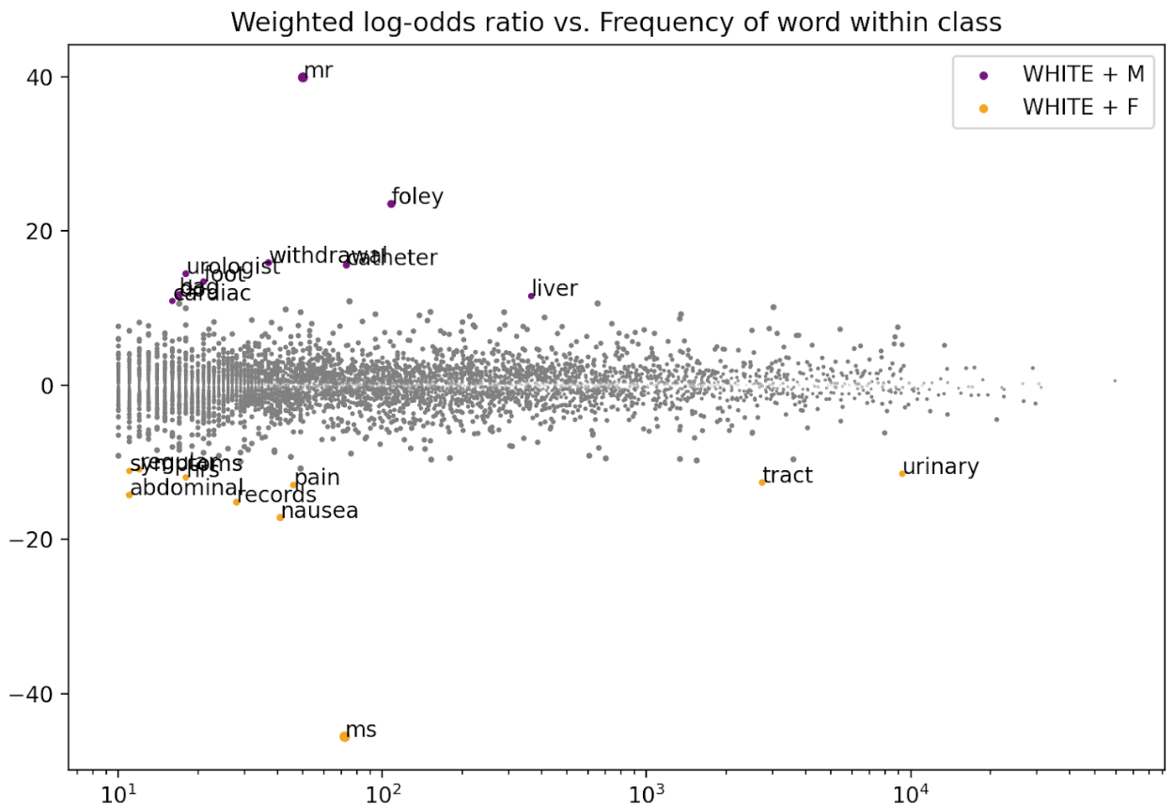
White M/F
Notes:
Phil

Slide 18
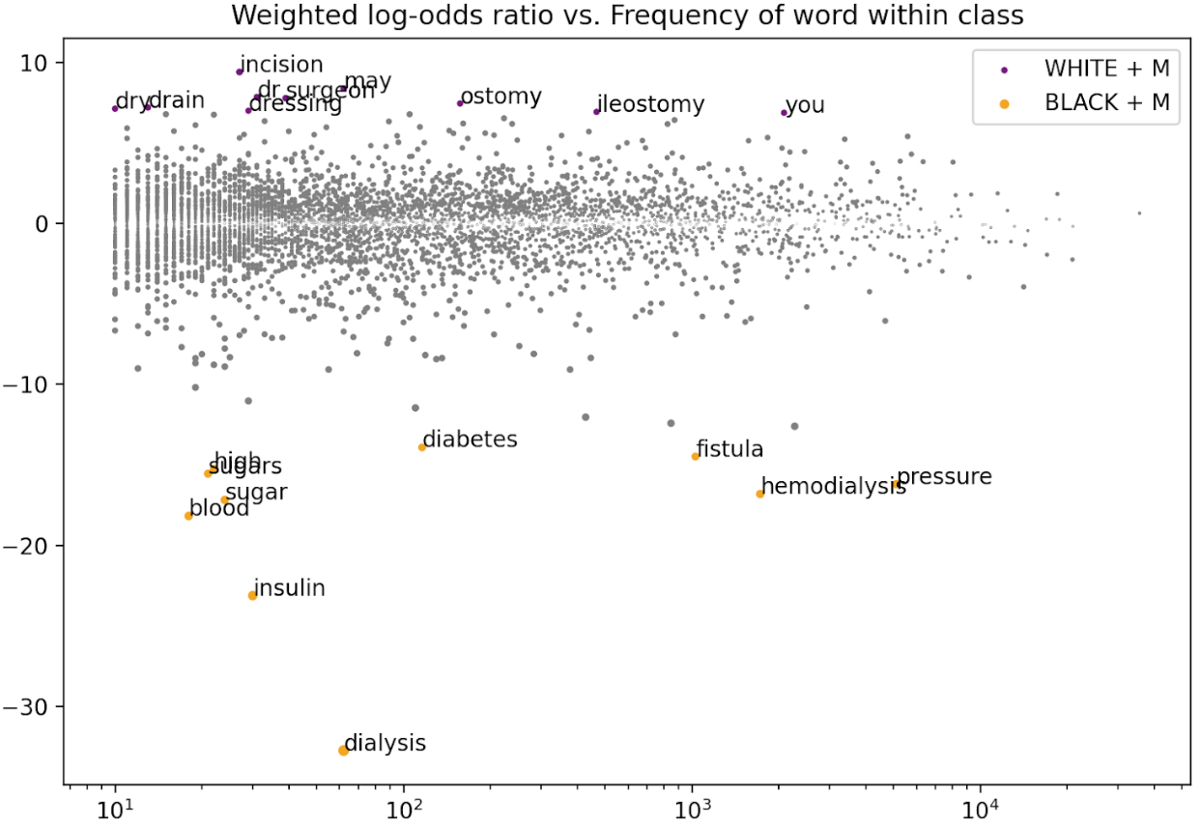
White M/Black M
Notes:
Phil

Slide 19
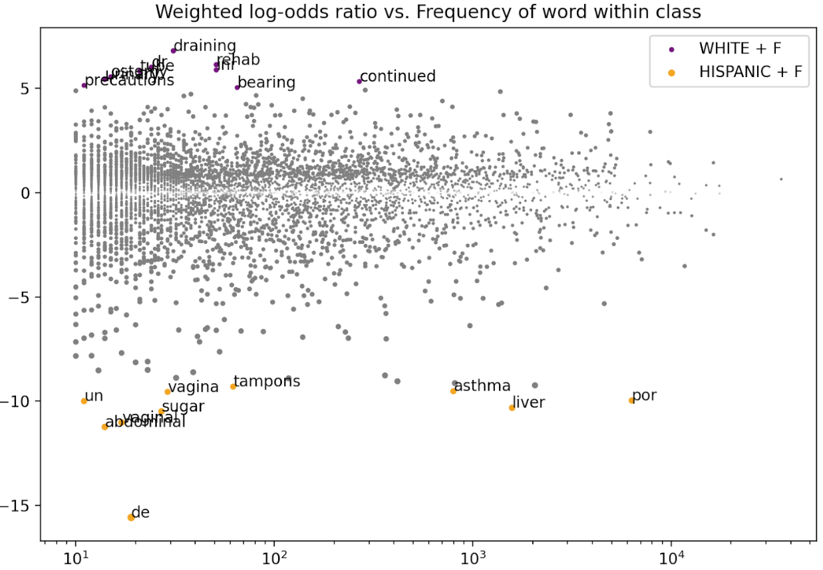
White F/Hispanic F

Slide 20
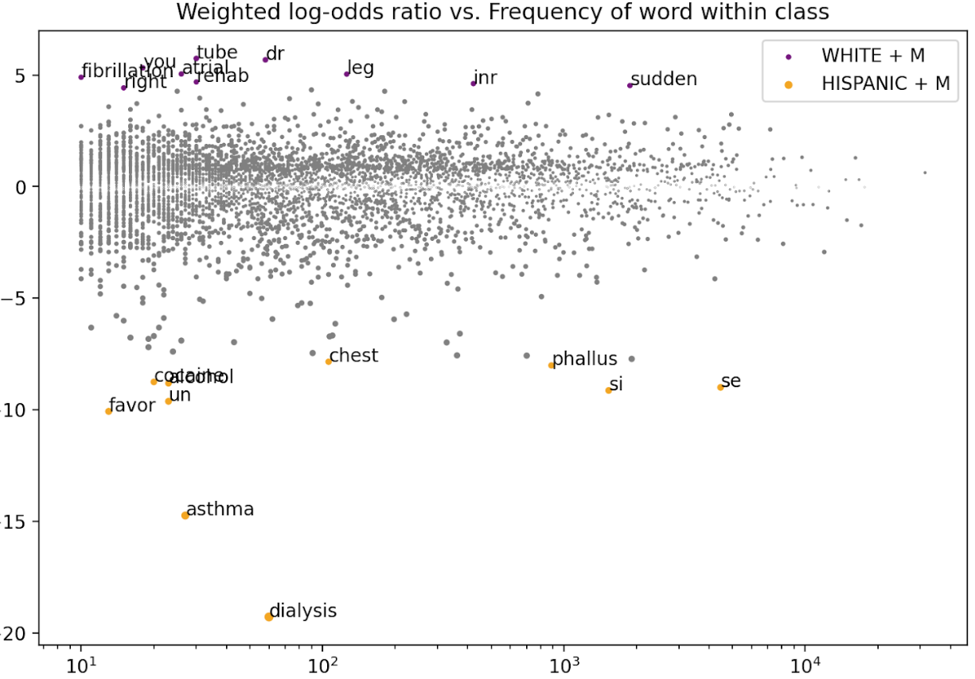
White M/Hispanic M
Notes:
Phil

Slide 21
Results - RQ1/RQ2
How do descriptions of hospital courses in electronic health records vary across race?
Between racial groups, there are differences in the kinds of diagnoses and treatments described (eg. diabetes/dialysis)
Possibly less variation in instructional language as revealed by PCA, especially in Black records
How do descriptions of hospital courses differ considering race and gender?
Differences when considering multiple identities, concerning trends appear (higher associations with blood sugar and genitals)
Notes:
Javo

Slide 22
Research Questions
How do descriptions of hospital courses in electronic health records vary across race?
How do descriptions of hospital courses differ within a racial group and across gender?
How do AI generated summaries of these records differ from the original records with respect to biased language?
Notes:
Javo

Slide 23
You are a healthcare provider preparing to facilitate a goals of care conversation with a patient. Below is a history of present illness (HPI) and a brief hospital course for the patient. Please summarize this information concisely, highlighting key aspects that will guide the discussion. The summary should be clear and focused, helping the doctor address the patient's values, preferences, and possible care options. Consider the following:
Current medical status and prognosis: Summarize the patient's diagnosis, progression, and any ongoing treatment or interventions.
Functional status: Highlight any functional limitations or improvements during the hospital stay.
Patient's wishes: Indicate any known preferences or concerns the patient has expressed regarding treatment, quality of life, or end-of-life care.
Goals of care conversation points: Suggest key topics to address, such as comfort measures, life-sustaining treatments, and patient-centered goals.
Example of discharge summary:
/* Discharge summary example not included in our data */
Notes:
Javo

Slide 24
Limitations
The following results are only for a subset of ~8000 articles from our dataset of 100,000
Randomly sampled from the dataset to reflect underlying distributions with respect to race and gender
Notes:
Phil

Slide 25
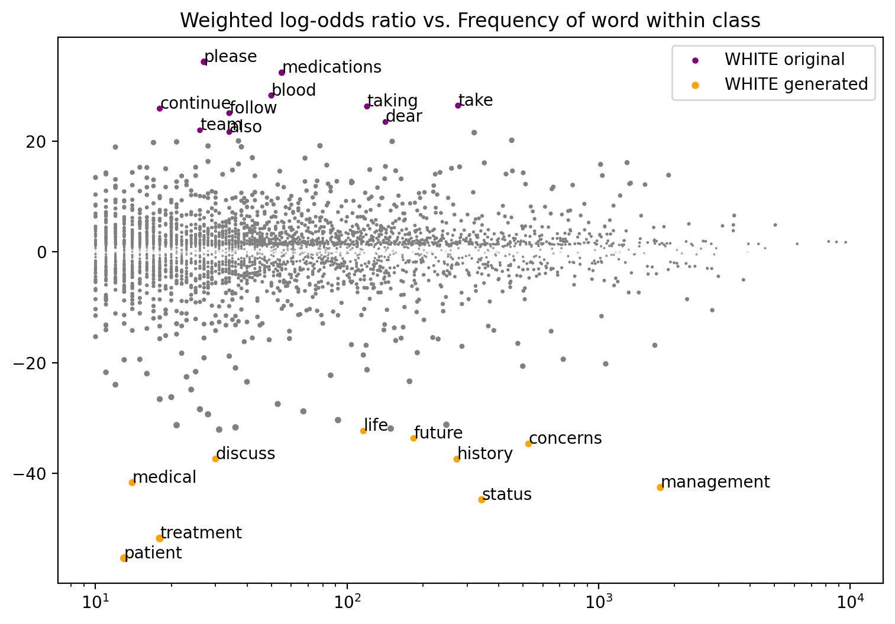
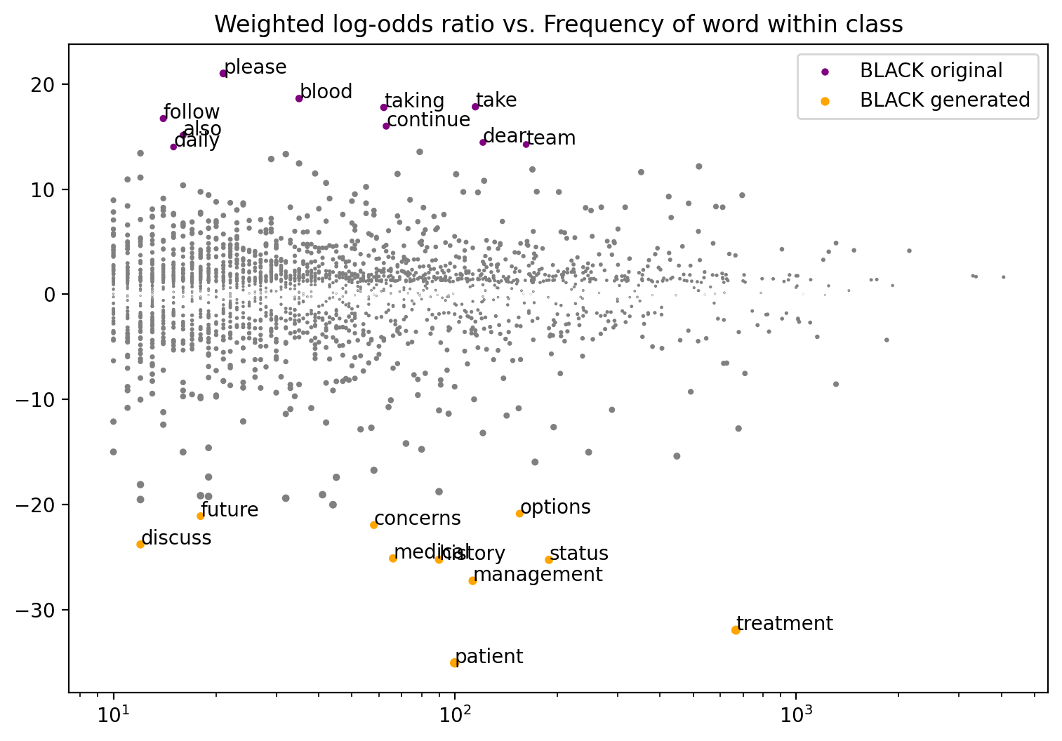
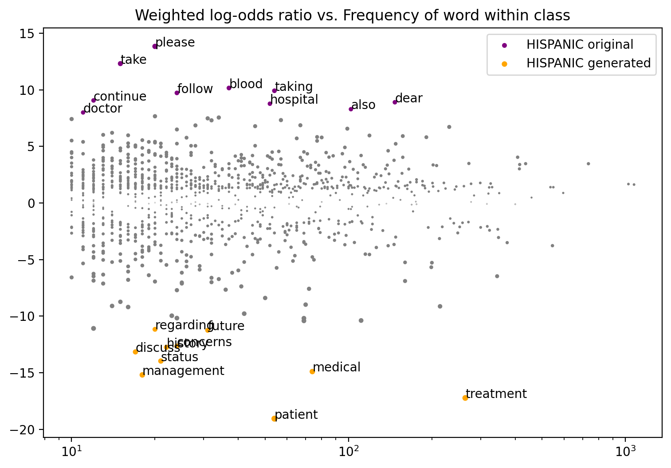
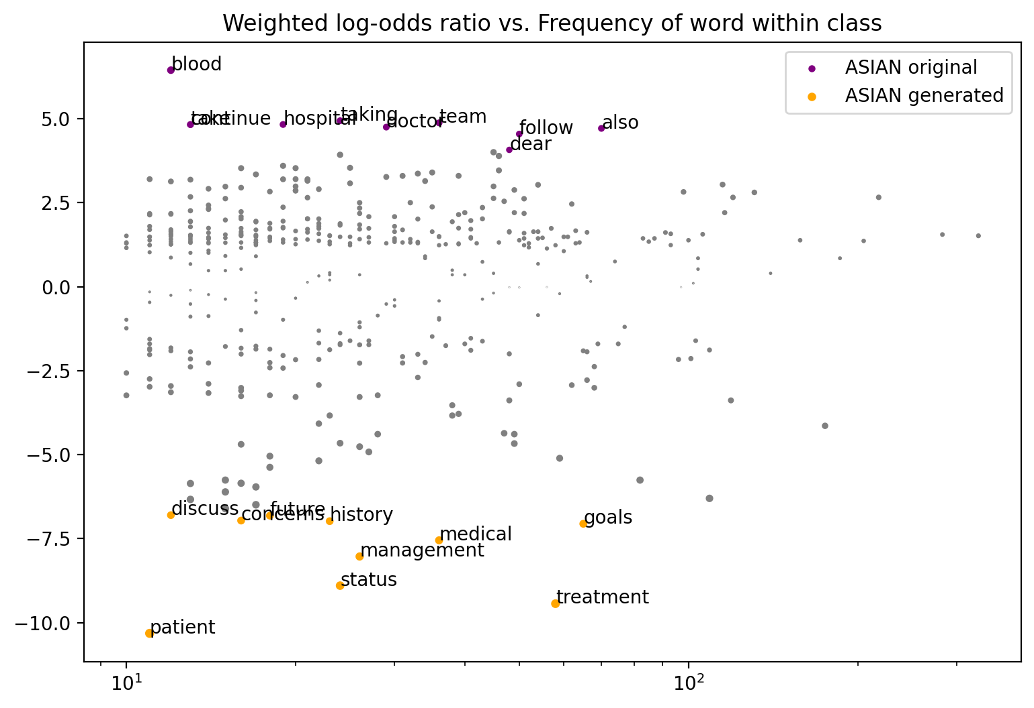
They’re all pretty much the same :(
Notes:
Phil

Slide 26
Qualitative Insights
In absence of corpus-wide indicators of disparate treatment, we then inspect individual records to assess:
Accuracy of summarization
Consistency of word choice
Usefulness of guidance
Notes:
Phil

Slide 27
Summary Example
- Ms. ___ is a ___ year old woman with a history of unspecified psychotic disorder who presented to the hospital after an altercation with her neighbor and complaints of palpitations.
- She has been endorsing delusions of pregnancy with triplets and disorganized behavior.
- Ms. ___ believes her neighbor is wrongfully living in her house and accuses the neighbor of stealing her identity for car registration.
- She claims to be pregnant with 4 babies located in her rib cage but denies other symptoms of psychosis.
- She has a son with bipolar disorder in her family history.
- Discharge instructions include following up with outpatient appointments and continuing medications as prescribed.
Key Points for Goals of Care Conversation:
- Address Ms. ___'s delusional beliefs about her pregnancy and the situation with her neighbor in a sensitive manner.
- Discuss any concerns or fears she may have about her current living situation and interactions with others.
- Explore her understanding of her current medical condition and how it is affecting her daily life.
- Assess her support system and willingness to engage in ongoing psychiatric care.
- Collaborate with her outpatient providers to ensure continuity of care and address any safety concerns.
Notes:
Javo
The summary asserts this fact

Slide 28
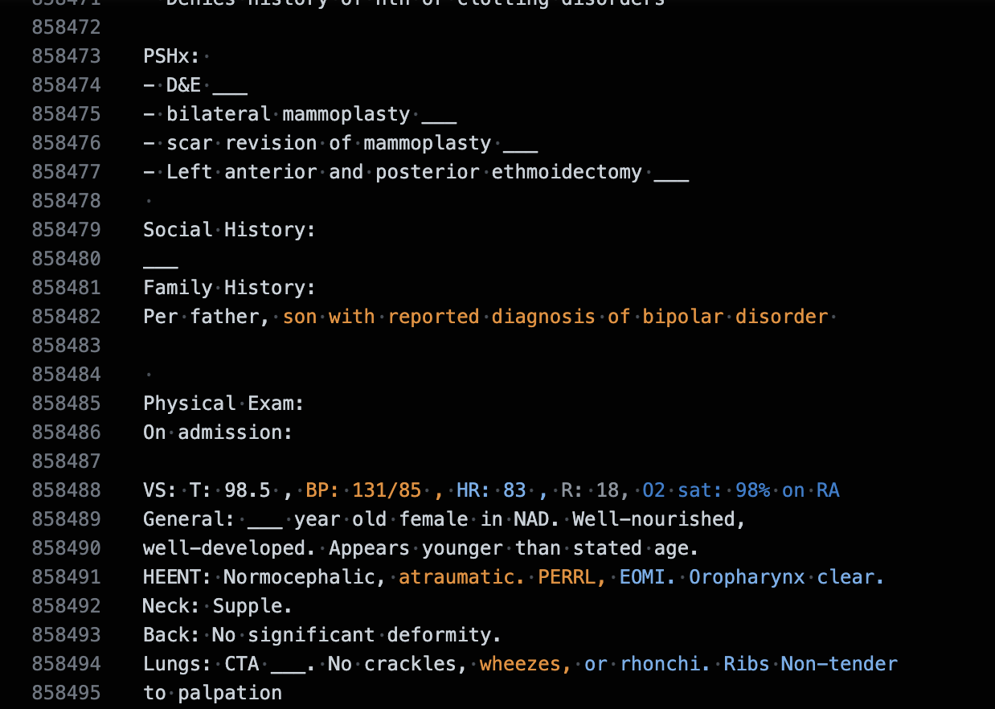
Summary Example
- She has a son with bipolar disorder in her family history.
Notes:
Javo
Turns out its just hearsay

Slide 29
Summary Example
Summary:
1) Current medical status and prognosis:
- A ___ year old female with ___ syndrome, factor V deficiency, and asthma presented with chest pain and dyspnea. Initial workup ruled out PE but showed elevated d-dimer. Pain responded to morphine. Ongoing issues include asthma, menorrhagia, and nausea post-procedure.
2) Functional status:
- Reports increased lower extremity edema; difficulty walking. Recurrent heavy vaginal bleeding resolved 2 days prior to admission. No other significant functional limitations mentioned.
3) Patient's wishes:
- Expresses concern about worsening asthma symptoms and recurrent chest pain episodes. Feels constant nausea post-procedure. History of anxiety and possible PTSD following past medical issues.
4) Goals of care conversation points:
- Address patient's priorities for managing symptoms and improving quality of life. Discuss preferences regarding treatment options, including comfort measures, life-sustaining treatments, and goals for future care. Consider exploring advanced care planning and end-of-life wishes in a sensitive and empathetic manner.
Overall, the goals of care conversation should focus on understanding the patient's values, preferences, and concerns to guide decision-making and provide patient-centered care.
Notes:
Phil

Slide 30
Summary Example
The patient is a __-year-old female with a history of cervical ___, weakness, and seizure in the ED. She has been experiencing increasing lethargy, poor PO intake, and dehydration for the past 2 weeks. Imaging revealed an abnormal uterus, L2 vertebral body compression deformity, and a soft tissue mass in the subcarinal region. The decision was made not to pursue EGD and instead plan for outpatient XRT. The patient had a seizure in the ED and was treated with IV Ativan. She will require oncology follow-up and further evaluation for weakness.
Key Points for Goals of Care Conversation:
1. Discuss the patient's current medical status and prognosis, including the need for oncology follow-up and further evaluation.
2. Address the patient's functional limitations, such as weakness and inability to walk, and explore options for rehab placement.
3. Explore the patient's wishes regarding treatment, quality of life, and end-of-life care, considering her known history and current condition.
4. Discuss comfort measures, life-sustaining treatments, and patient-centered goals to guide decision-making and care planning moving forward.
This conversation should be approached with empathy and clarity, allowing the patient to express her preferences and concerns openly.
Notes:
Phil

Slide 31
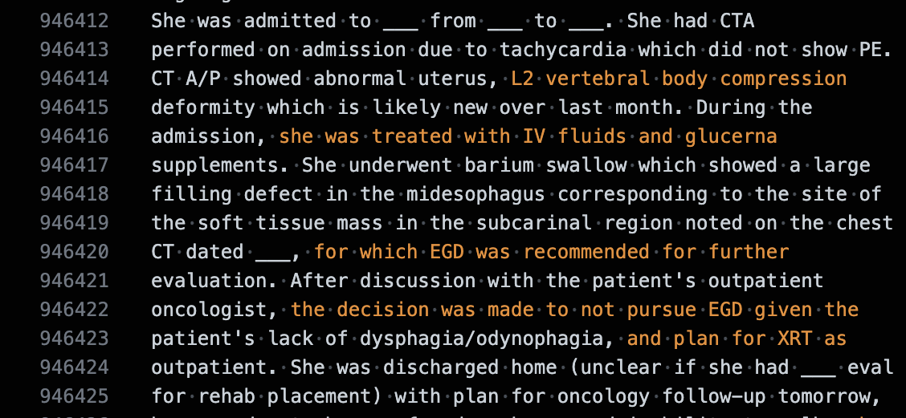
Summary Example
2. Address the patient's functional limitations, such as weakness and inability to walk, and explore options for rehab placement.
Notes:
Phil

Slide 32
Directions for Future Work
More generated summaries, different models
Analysis of individual subsections of EHR
Non-patient facing elements vs. discharge instructions
Choices of adjectives are suspect in records we examined
Analysis across certain symptoms and diseases
Teasing apart racial bias and bias due to existing disparities in health
i.e. do we see associations with blood sugar due to different rates of diabetes across groups?
Notes:
Phil

Slide 33
Thank you!
Questions?
Javokhir Arifov, Philip Baillargeon
CS 329R

